Slide 1

KGiSL INSTITUTE OF TECHNOLOGY
(An Autonomous Institution)
COIMBATORE
DEPARTMENT OF ELECTRONICS & COMMUNICATION ENGINEERING
Project phase review # 02
SOLAR PANEL DEFECT DETECTION AND MONITORING SYSTEM
Team Members: 711721106061 MANISHA K
711721106007 ADSHAYA S S
711721106017 BALAMURUGAN R
711721106059 MADHUMITHA P
Under the guidance of : Ms. Rajarajeswari .K , Assistant Professor/ECE

Slide 2
AGENDA
Introduction
Literature Survey and Background Research
Problem Identification and Objectives
Existing System
Proposed System
Module 1
Module 2
Module 3
Module 4
Proposed block diagram
Methodology and Technical Approach
Implementation and Execution
Analysis and Result
Project outcome and impact
References
Publication
Timeline
Notes:
Documentation and Report Quality (10 Marks)

Slide 3
INTRODUCTION
Dust accumulation, surface burns, and physical damage can go unnoticed. Over time, these problems cause gradual performance degradation.
Damaged solar panels lead to decrease in energy output that Reducing overall efficiency and wasting potential energy.
Higher electricity costs due to reduced solar power generation and Expensive repairs due to late identification of issues.

Slide 4
LITERATURE SURVEY
TITLE | PUBLICATION DETAILS | METHODOLOGY/ ALGORITHMS | MERITS | DEMERITS
Intelligent Solar Panel Management using VGG16. | Authors: A. Kaur, K. S. Gill, N. Thapliyal and R. S. Rawat Publication: Gwalior, India, 2024, pp. | The model classifies solar panel images into six categories: clean, dusty, bird drop, electrical damage, physical damage, and snow-covered. It uses a pre-trained VGG16 convolutional neural network (CNN) to extract complex features from images for accurate classification. . | The VGG16 model achieved 92.7% accuracy in identifying solar panel defects, ensuring reliable fault detection. | The model was trained on only 875 images, which may limit its ability to generalize to all real-world conditions. Deep learning models like VGG16 require high processing power, making implementation costly for some users. .

Slide 5
LITERATURE SURVEY
TITLE | PUBLICATION DETAILS | METHODOLOGY/ ALGORITHMS | MERITS | DEMERITS
Enhanced Fault Detection and Classification in Solar PV Systems Using RNN and IoT Integration | Authors: Suganya Govindarajan , Vasantharaj Subramanian ,Kanimozhi. R Abinayasree. J , Elanangai. G Publication: vol. 13, no. 7, November 2023, pp. | The methodology involves integrating IoT-based monitoring with a Recurrent Neural Network (RNN) to detect and classify faults in solar PV systems. Voltage and current data from solar panels are collected using sensors and transmitted in real-time to an RNN model. classify faults such as open circuits, short circuits, and potential difference. | Accuracy in fault classification up to 94% due to the use of the RNN model The system can be easily integrated into existing PV setups | The use of RNN with transformer architecture increases computational complexity, requiring more processing power.

Slide 6
LITERATURE SURVEY
TITLE | PUBLICATION DETAILS | METHODOLOGY/ ALGORITHMS | MERITS | DEMERITS
Solar Cell Surface Defects Detection based on Computer Vision | Authors: Xiaoliang Qian, Heqing Zhang, Huanlong Zhang, Yuanyuan Wu, Zhihua Diao, Qing-E Wu, Cunxiang Yang* Publication: vol. 13, no. 7, November 2023, pp. | The captured image is integrally transformed. The transformed image is properly processed and inversely transformed to obtain the detection results. | Provides an overview of state-of-the-art computer vision methods for identifying solar panel defects. Organizes defect detection techniques into three categories, making it easier to understand their effectiveness. | The proposed method relies on weakly-labeled data, which may not always provide accurate defect detection. Deep neural networks require high processing power, making them challenging to deploy on low-resource systems.

Slide 7
LITERATURE SURVEY
TITLE | PUBLICATION DETAILS | METHODOLOGY/ ALGORITHMS | MERITS | DEMERITS
Solar Panel Fault Detection Using Internet of Things | Authors:Ramya Shri G, Anish B, Gokul B, Harish M, and P Kavin Publication: 2024 Chinese Control And Decision Conference (CCDC 2024) | IoT-based setup involving Arduino Uno, and various sensors (LDR, voltage, and current to monitor the performance of solar panels. It detects dust accumulation and faults by measuring voltage, current, and light intensity and displayed on LED screen, cloud | It uses low-cost hardware and enables remote access to performance data through cloud integration, enhancing maintenance and management. | It can only alert users when faults occur but lacks automatic corrective actions.

Slide 8
PROBLEM IDENTIFICATION
Voltage and Current Drop Not Always Traced to Root Cause
Need for High-Quality Training Data in AI Models
Undetected shading
High Maintenance Costs and Inefficiencies
Voltage Drop and Energy Losses

Slide 9
OBJECTIVE
To develop a real-time IoT-based monitoring system for solar PV panels that enables early fault detection, allowing timely maintenance and reducing system downtime.
To display real-time information and fault alerts on an LCD screen and to send fault alerts to mobile phones using IoT platforms .
To improve solar panel efficiency and ensure consistent power generation.

Slide 10
EXISTING SYSTEM
Existing systems for solar PV monitoring focus mainly on basic electrical parameters and lack comprehensive environmental monitoring. They do not provide mobile alerts, require manual monitoring, and are limited in detecting various faults.

Slide 11
PROPOSED SYSTEM
The proposed system involves a voltage-based monitoring approach to detect defects in solar panels. It continuously measures the voltage output of each panel, comparing the values against prede predefined thresholds. When a defect is identified, such as a drop in voltage caused by dust, cracks, or burns, the system automatically flags the defective panel.
The location of the panel is recorded, and an email notification is sent to the maintenance team with the defect details and its precise location. This system ensures quick identification, timely repairs, and enhanced efficiency in solar panel operations.

Slide 12
Modules
MICROCONTROLLER(ESP32 WROOM 32)
LIGHT INTENSITY SENSOR(BH1750)
LIQUID CRYSTAL DISPLAY (LCD)
TEMPERATURE AND HUMIDITY(DHT22)
DUST SENSOR(GP2Y1010AU0F)

Slide 13
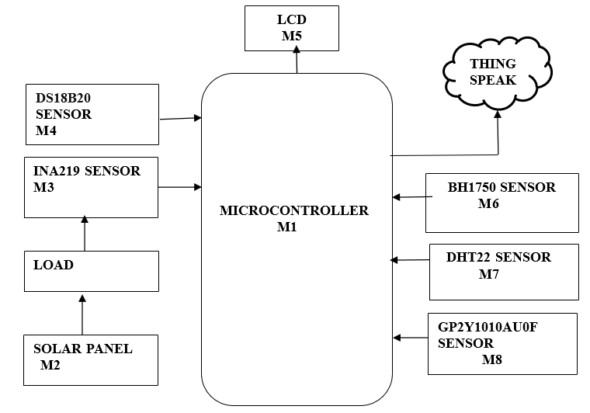
Block Diagram

Slide 14
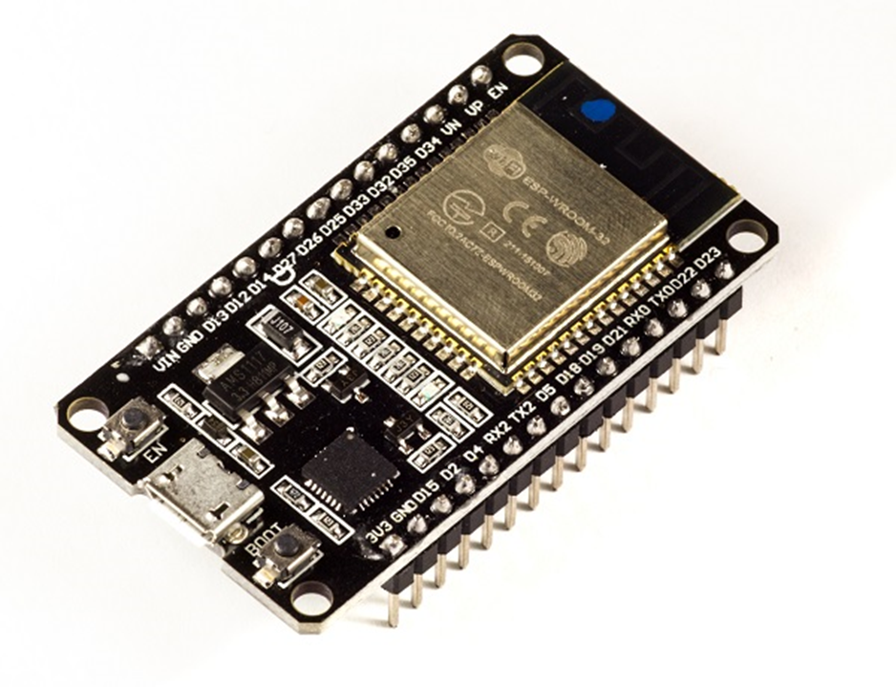
Module 1 – ESP32 WROOM 32(microcontroller)
The development board equips the ESP-WROOM-32 module containing Tensilica Xtensa® Dual-Core 32-bit LX6 microprocessor.
This processor is similar to the ESP8266 but has two CPU cores, operates at 80 to 240 MHz adjustable clock frequency and performs at up to 600 Dhrystone Million Instructions Per Second.

Slide 15
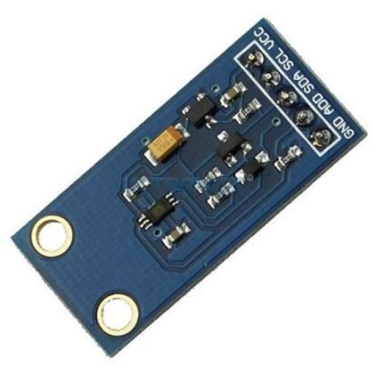
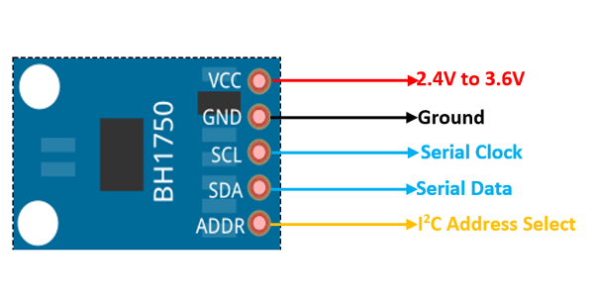
Module 2 – BH1750(light intensity sensor)
The main component is BH1750FVI IC.
The module works on 3.3V so a voltage regulator is used.
The lux values from BH1750 through I2C bus.
The ADC in the IC converts the analog illuminance to the digital lux value.

Slide 16
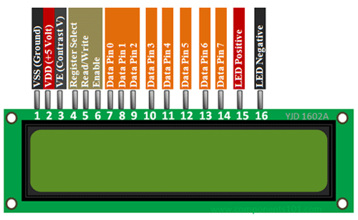
Module 3 – LIQUID CRYSTAL DISPLAY (LCD)
RAM | 80
ROM | 240
5 x 8 dots with cursor | 1/8
5 x 10 dots with cursor | 1/11
5 x 8 dots with cursor | 1/16

Slide 17
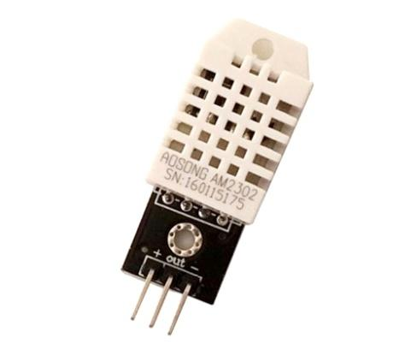
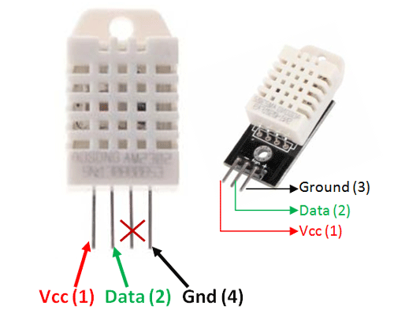
Module 4- DHT22(temperature and humidity sensor)
The DHT22 is a low-cost, highly accurate digital sensor used to measure both temperature and humidity.
It can measure temperatures ranging from -40°C to +80°C with an accuracy of ±0.5°C, and humidity levels from 0% to 100% with an accuracy of ±2–5%.

Slide 18
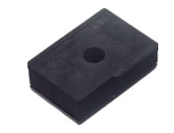
Module 5 - DUST SENSOR
Supply voltage | -0.3 to +7
Input terminal voltage | -0.3 to Vcc
Operating temperature | -10 to +65
Soldering temperature | -20 to +85

Slide 19
Software
Arduino IDE
Proteus IDE
Embedded C
MySQL Database
Thing Speak

Slide 20
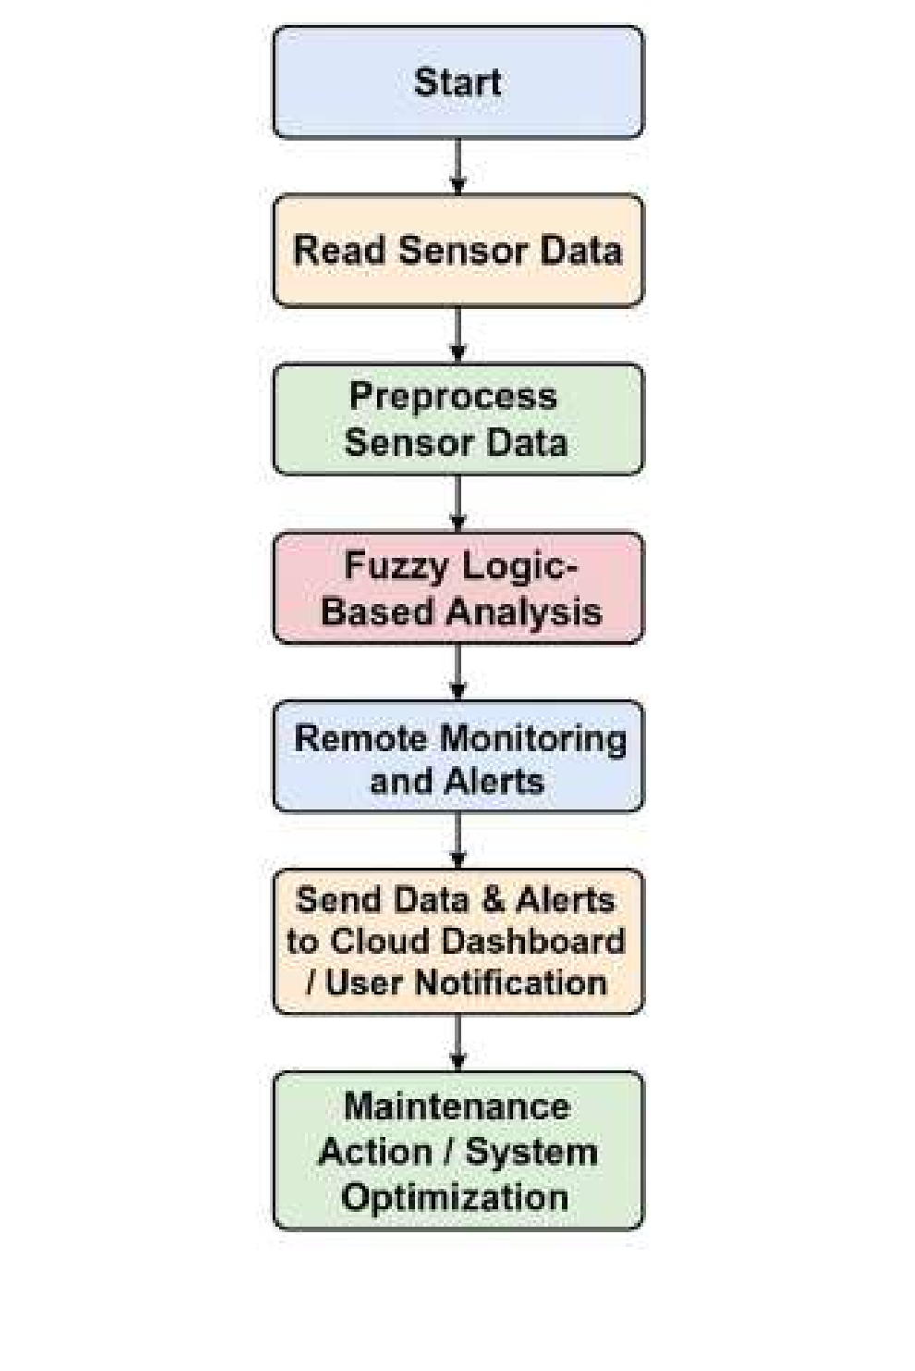
FLOW CHART

Slide 21
METHODOLOGY AND TECHNICAL APPROACH
Data Acquisition
Data Processing
Cloud Storage and Remote Access
Hardware components
Software components

Slide 22
METHODOLOGY AND TECHNICAL APPROACH
Data Acquisition: Voltage, current, temperature, humidity, light intensity, and dust sensors continuously collect real-time data from the solar panels.
Data Processing :The microcontroller compares real-time sensor readings with predefined threshold values to detect defects in the panel, such as overheating or voltage drops.
Cloud Storage and Remote Access: Data is stored in a database and can be accessed remotely for monitoring and analysis.

Slide 23
Hardware Components:
ESP32 microcontroller
sensors,
Wi-Fi module,
LCD display.
Software Components:
Arduino IDE,
Proteus IDE,
ThingSpeak

Slide 24
IMPLEMENTATION AND EXECUTION
The ESP32 microcontroller collects real-time data from the solar panel and transmits that data to the cloud server using Wi-Fi.
Embedded C programming is used for coding, and Proteus IDE is utilized to simulate the circuit.
The system was tested under various conditions, including clean, dusty, shaded, and high-temperature environments to ensure reliability and accuracy.

Slide 25
ANALYSIS AND RESULT
The system monitored voltage, temperature, and dust levels, ensuring consistent energy output.
Timely cleaning and preventive maintenance reduced power losses and improved efficiency.
Remote monitoring minimized manual inspections and operational costs, enhancing sustainability.
The system tracked panel performance, detecting voltage drops, overheating, and dust accumulation for quick issue identification.
Maintenance scheduling based on dust and temperature minimized energy losses, improving efficiency.
Predictive maintenance and remote monitoring reduced manual inspections and costs, enhancing reliability.

Slide 26
PROJECT OUTCOME AND IMPACT
Real-time monitoring of solar panel voltage for continuous performance tracking.
Automated alerts sent to the maintenance team with defect details and exact panel location.
Lower maintenance costs due to early detection of defects and proactive maintenance.
Improved efficiency in solar power generation through timely repairs.

Slide 27
REFERENCE
1) A. Kaur, K. S. Gill, N. Thapliyal and R. S. Rawat, "Intelligent Solar Panel Management using VGG16 and Accessing Early Damage Insights," 2024 IEEE 3rd World Conference on Applied Intelligence and Computing (AIC), Gwalior, India, 2024, pp. 163-166, doi: 10.1109/AIC61668.2024.10731073
2) J.C. Torres, H. Chfii, J. Marí-Guaita, Y.H. Khattak, F. Baig, et al., Delafossite as hole transport layer a new pathway for efficient perovskite-based solar sells: insight from experimental, DFT and Numerical Analysis. Solar Energy 250 (2023).
3) P. Haidari, A. Hajiahmad, A. Jafari, A. Nasiri, Deep learning-based model for fault classification in solar modules using infrared images, Sustain. Energy Technol. Assess. 52 (2022).
4) A. Bouich, Study and characterization of hybrid perovskites and copper-indiumgallium selenide thin films for tandem solar cells, Tesis Doctoral. Universitat Polit`ecnica De Val`encia (2021).
J. Chen, Y. Li and Q. Ling, "Hot-Spot Detection for Thermographic Images of Solar Panels," 2020 Chinese Control And Decision Conference (CCDC), Hefei, China, 2020, pp. 4651-4655, doi: 10.1109/CCDC49329.2020.9164255.

Slide 28
REFERENCE
6) S.R.Joshua, S. Park and K. Kwon, "AI-Driven Green Campus: Solar Panel Fault Detection Using ResNet-50 for Solar-Hydrogen System in Universities," 2024 IEEE 24th International Conference on Software Quality, Reliability, and Security Companion (QRS-C), Cambridge, United Kingdom, 2024, pp. 316-325, doi: 10.1109/QRS-C63300.2024.00048.
7) S.Dunga, O. Oni, and O. M. M. Abinaya, S. Shanthi and R. Subha, "Early Fault Detection in Solar Panels Using Machine Learning," 2022 8th International Conference on Advanced Computing and Communication Systems (ICACCS), Coimbatore, India, 2022, pp. 2095-2099, doi: 10.1109/ICACCS54159.2022.9785291.2023. [Online]. Available: https://www.mdpi.com/2673-4591/41/1/12
8) M. N, D. E, D. P. G. S and G. V, "A Novel Method for Fault Detection and Protection in Solar Photo Voltaic Arrays," 2022 IEEE 2nd Mysore Sub Section International Conference (MysuruCon), Mysuru, India, 2022, pp. 15, doi: 10.1109/MysuruCon55714.2022.9972487.

Slide 29
PUBLICATION
Ms.K.Rajarajeshwari, Manisha.k, Adshaya S ,Balamurugan R, Madhumitha P “SOLAR PANEL DEFECT DETECTION AND MONITORING SYSTEM “.
International Journal of Scientific Research in Engineering and Management (IJSREM) on Volume 09 Issue 05 May - 2025.
DOI: 10.55041/IJSREM47865

Slide 30
TIMELINE
Particulars | Jan-25 |  | Feb-25 |  |  |  | Mar-25 |  |  |  | Apr-25
 | Wk3 | Wk4 | Wk1 | Wk2 | Wk3 | Wk4 | Wk1 | Wk2 | Wk3 | Wk4 | Wk1 | Wk2 | Wk3 | Wk4
Problem Identification
Literature survey
Module 1
Module 2
Module 3
Module 4
Thesis draft
Final Thesis
Viva

Slide 31
THANK YOU

